Slide 1
White-box testing techniques contd…
Dr. Durga Prasad Mohapatra
Professor, Dept. of CSE
N.I.T Rourkela
‹#›

Slide 2
Path Coverage
Design test cases such that:
  All linearly independent paths in the program are executed at least once.
Defined in terms of
  Control flow graph (CFG) of a program.
‹#›

Slide 3
Path Coverage-Based Testing
To understand the path coverage-based testing:
  we need to learn how to draw control flow graph of a program.
A control flow graph (CFG) describes:
  The sequence in which different instructions of a program get executed.
  The way control flows through the program.
‹#›

Slide 4
How to Draw Control Flow Graph?
Number all statements of a program.
Numbered statements:
  Represent nodes of control flow graph.
An edge from one node to another node exists:
  If execution of the statement representing the first node
    Can result in transfer of control to the other node.
‹#›

Slide 5
Example
int f1(int x,int y){
1 while (x != y){
2 if (x>y) then
3 x=x-y;
4 else y=y-x;
5 }
6 return x; }
‹#›

Slide 6
Example Control Flow Graph
1
2
3
4
5
6
‹#›

Slide 7
How to Draw Control flow Graph?
Sequence:
  1 a=5;
  2 b=a*b-1;
1
2
‹#›

Slide 8
How to Draw Control Flow Graph?
Selection:
  1 if(a>b) then
  2 c=3;
  3 else c=5;
  4 c=c*c;
1
2
3
4
‹#›

Slide 9
How to Draw Control Flow Graph?
1
Iteration:
  1 while(a>b){
  2 b=b*a;
  3 b=b-1;}
  4 c=b+d;
2
3
4
‹#›

Slide 10
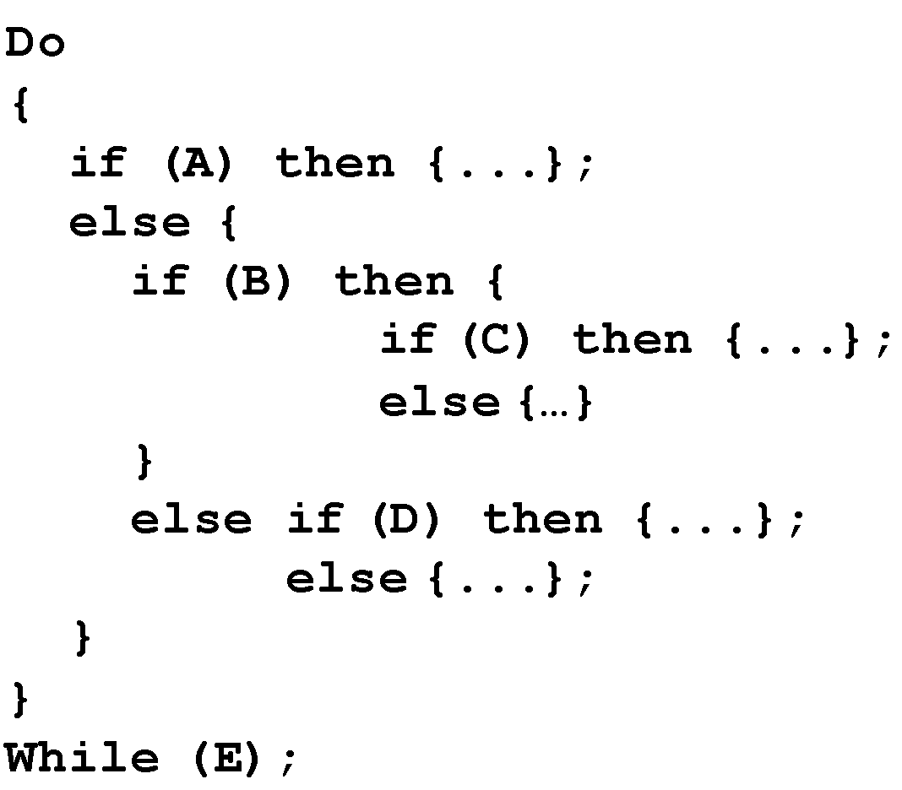
Example Code Fragment
‹#›

Slide 11
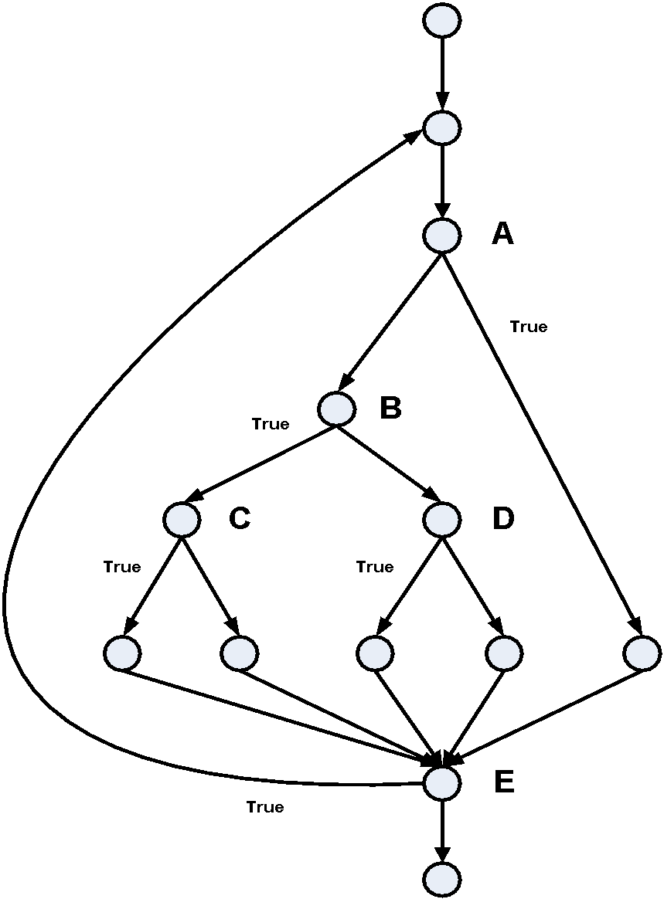
Example Control Flow Graph
‹#›
Source: The Art of Software Testing – Glenford Myers

Slide 12
Path
A path through a program:
  A node and edge sequence from the starting node to a terminal node of the control flow graph.
  There may be several terminal nodes for program.
‹#›

Slide 13
Linearly Independent Path
Any path through the program:
  Introduces at least one new edge:
    Not included in any other independent paths.
‹#›

Slide 14
Independent path
It is straight forward:
  To identify linearly independent paths of simple programs.
For complicated programs:
  It is not easy to determine the number of independent paths.
‹#›

Slide 15
McCabe's Cyclomatic Metric
An upper bound:
  For the number of linearly independent paths of a program
Provides a practical way of determining:
  The maximum number of linearly independent paths in a program.
‹#›

Slide 16
McCabe's Cyclomatic Metric
Given a control flow graph G,
cyclomatic complexity V(G):
  V(G)= E-N+2
    N is the number of nodes in G
    E is the number of edges in G
‹#›

Slide 17
Example Control Flow Graph
1
Cyclomatic complexity =
7-6+2 = 3.
2
3
4
5
6
‹#›

Slide 18
Cyclomatic Complexity
Another way of computing cyclomatic complexity:
  inspect control flow graph
  determine number of bounded areas in the graph
V(G) = Total number of bounded areas + 1
  Any region enclosed by a nodes and edge sequence.
‹#›

Slide 19
Example Control Flow Graph
1
2
3
4
5
6
‹#›

Slide 20
Example
From a visual examination of the CFG:
  Number of bounded areas is 2.
  Cyclomatic complexity = 2+1=3.
‹#›

Slide 21
Cyclomatic Complexity
McCabe's metric provides:
    A quantitative measure of testing difficulty and the ultimate reliability
Intuitively,
  Number of bounded areas increases with the number of decision nodes and loops.
‹#›

Slide 22
Cyclomatic Complexity
The first method of computing V(G) is amenable to automation:
  You can write a program which determines the number of nodes and edges of a graph
  Applies the formula to find V(G).
‹#›

Slide 23
Cyclomatic Complexity
The cyclomatic complexity of a program provides:
  A lower bound on the number of test cases to be designed
  To guarantee coverage of all linearly independent paths.
‹#›

Slide 24
Cyclomatic Complexity
A measure of the number of independent paths in a program.
Provides a lower bound:
  for the number of test cases for path coverage.
‹#›

Slide 25
Cyclomatic Complexity
Knowing the number of test cases required:
  Does not make it any easier to derive the test cases,
  Only gives an indication of the minimum number of test cases required.
‹#›

Slide 26
Practical Path Testing
The tester proposes initial set of test data :
  Using his experience and judgment.
A dynamic program analyzer used:
  Measures which parts of the program have been tested
  Result used to determine when to stop testing.
‹#›

Slide 27
Derivation of Test Cases
Draw control flow graph.
Determine V(G).
Determine the set of linearly independent paths.
Prepare test cases:
  to force execution along each path.
‹#›

Slide 28
Example
int f1(int x,int y){
1 while (x != y){
2 if (x>y) then
3 x=x-y;
4 else y=y-x;
5 }
6 return x; }
‹#›

Slide 29
Example Control Flow Diagram
1
2
3
4
5
6
‹#›

Slide 30
Derivation of Test Cases
Number of independent paths: 3
  1,6 test case (x=1, y=1)
  1,2,3,5,1,6 test case(x=2, y=1)
  1,2,4,5,1,6 test case(x=1, y=2)
‹#›

Slide 31
An Interesting Application of Cyclomatic Complexity
Relationship exists between:
  McCabe's metric
  The number of errors existing in the code,
  The time required to find and correct the errors.
‹#›

Slide 32
Cyclomatic Complexity
Cyclomatic complexity of a program:
  Also indicates the psychological complexity of a program.
  Difficulty level of understanding the program.
‹#›

Slide 33
Cyclomatic Complexity
From maintenance perspective,
  Limit cyclomatic complexity of modules
    To some reasonable value.
  Good software development organizations:
    Restrict cyclomatic complexity of functions to a maximum of ten or so.
‹#›

Slide 34
White-Box Testing : Summary
weakest
statement
coverage
condition
coverage
branch
(or decision)
coverage
branch and condition
(or condition /decision) coverage
modified condition / decision coverage
independent path (or basis path)
coverage
multiple- condition
coverage
only if paths across
composite conditions
are distinguished
strongest
path
coverage
‹#›

Slide 35
Summary
There are two approaches to testing:
  black-box testing and
  white-box testing.
Designing test cases for black box testing:
  does not require any knowledge of how the functions have been designed and implemented.
  Test cases can be designed by examining only SRS document.
‹#›

Slide 36
Summary
White box testing:
  Requires knowledge about internals of the software.
  Design and code is required.
We have discussed a few white-box test strategies.
  Statement coverage
  Branch coverage
  Condition coverage
  MC/DC coverage
  Path coverage
‹#›

Slide 37
Summary
A stronger testing strategy:
  Provides more number of significant test cases than a weaker one.
  Condition coverage is strongest among strategies we discussed.
We discussed McCabe’s Cyclomatic complexity metric:
  Provides an upper bound for linearly independent paths
  Correlates with understanding, testing, and debugging difficulty of a program.
‹#›

Slide 38
References
Rajib Mall, Fundamentals of Software Engineering, (Chapter – 10), Fifth Edition, PHI Learning Pvt. Ltd., 2018.
Naresh Chauhan, Software Testing: Principles and Practices, (Chapter – 5), Second Edition, Oxford University Press, 2016.

Slide 39
Thank you
‹#›

